Slide 1

PREDICTIVE ANALYSIS
INTRODUCTION, REGRESSION, TIME SERIES ANALYSIS
data-action-lab.com

Slide 2
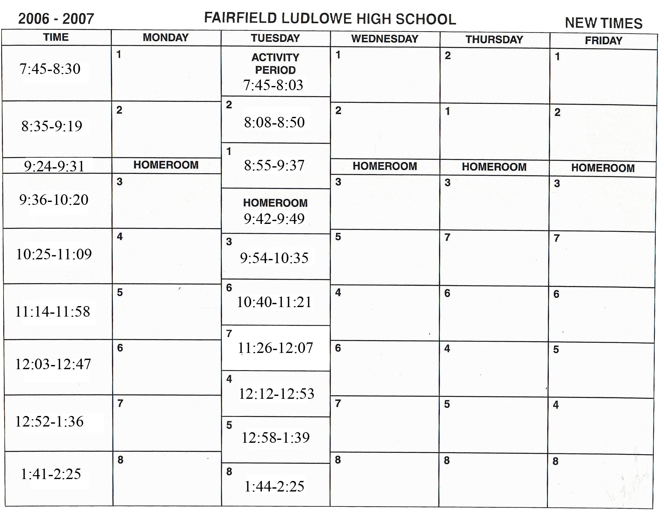
PREDICTION – AN ATTAINABLE GOAL?
We are better at predicting than we might admit.
As well, we often set up our environment so that it is more predictable.
At the same time, we continue to try to push the boundaries of what we are able to predict.

Slide 3
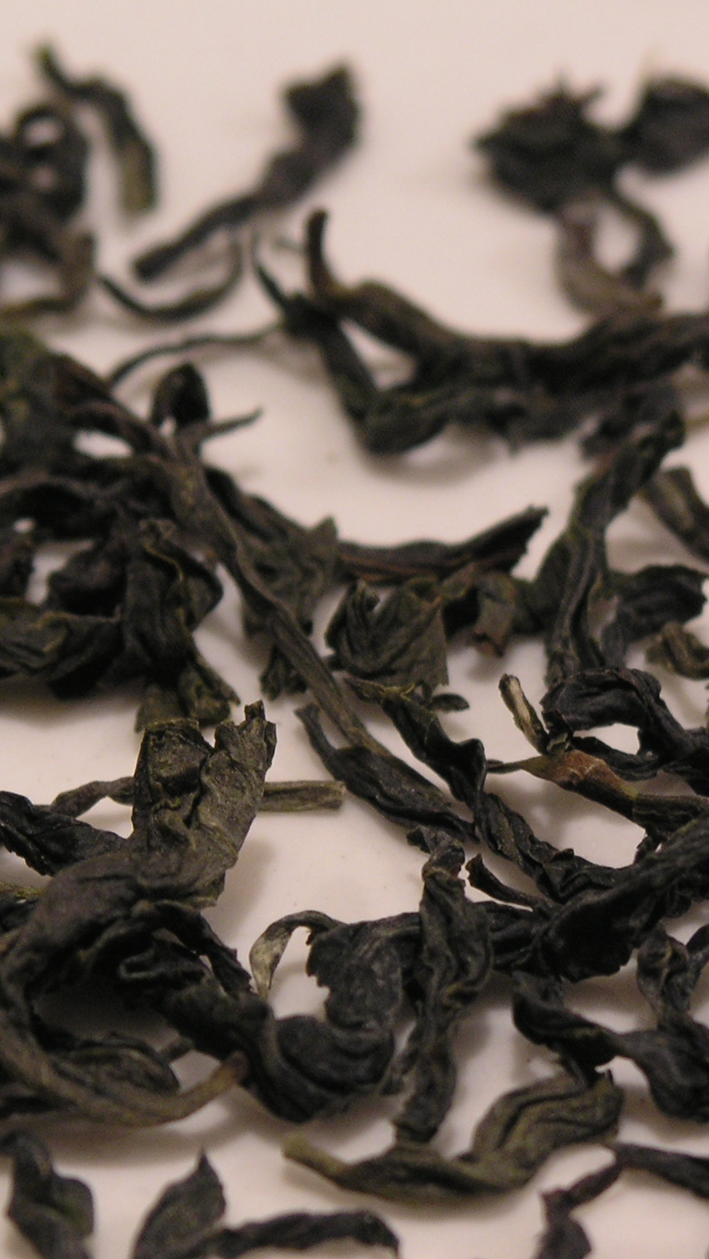
SOOTHSAYERS, FORTUNE TELLERS AND PROGNOSTICATORS
Over time, we have tried many strategies to predict the future:
Divination
Rituals
Dreams and Trances
Our enjoyment of games of chance suggest that sometimes we like an element of not knowing.
The development of probability and statistics offered up a way to quantify what we do know, and formalize our efforts to predict what we don’t know.

Slide 4
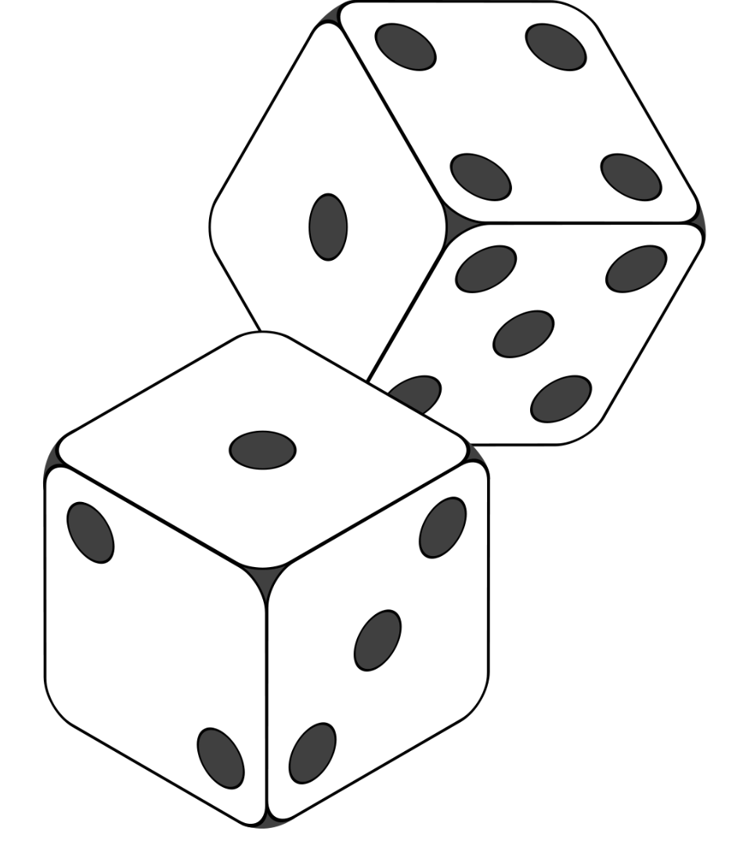
History of PROBABILITY
Prior to 1700s: Many cultures around the world develop concepts relating to possible combinations and permutations of events, as well as the odds of events happening.
1700s: Probability starts to have a sound mathematical basis (e.g. concept of an expected value).
1800s: A variety of fundamental concepts and tenets of modern probability theory are developed.
1900s: Statistics becomes more fully integrated into the scientific method. The frequentist vs Bayesian debate emerges.
Art: Steaphan Greene [CC BY-SA 3.0 (https://creativecommons.org/licenses/by-sa/3.0)]

Slide 5
Regression Analysis – The Basics

Slide 6
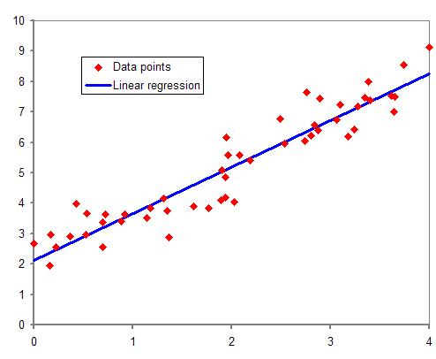
Regression Analysis – Some Background
Devised by Legendre and Gauss, independently, in the context of analyzing astronomical observations.
Galton coined the term ‘regression’ with respect to a specific biological context (relating to human height)
This term stuck, however. It is now used more generally to describe estimating the relationship between a dependent and independent variables.
(https://en.wikipedia.org/wiki/Regression_analysis)

Slide 7
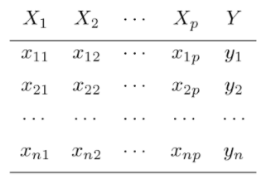
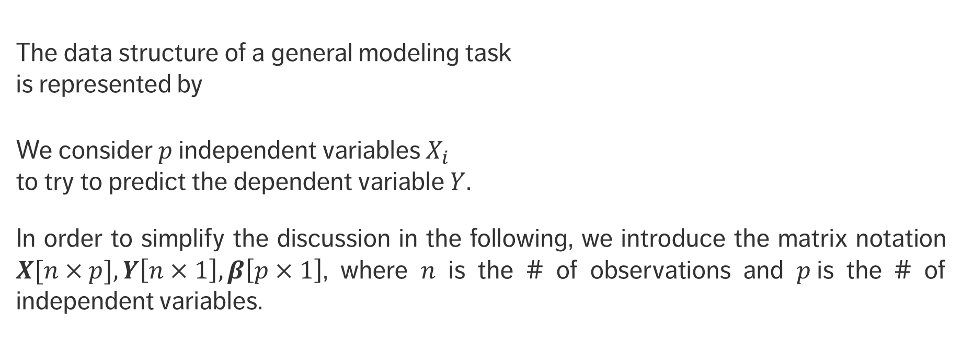
Regression Modeling
The data structure of a general modeling task is represented by
We consider $p$independent variables $X_{i}$ to try to predict the dependent variable $Y$.
In order to simplify the discussion in the following, we introduce the matrix notation $X[n×p], Y\left[n×1\right], β\left[p×1\right]$, where $n$ is the # of observations and $p$is the # of independent variables.

Slide 8
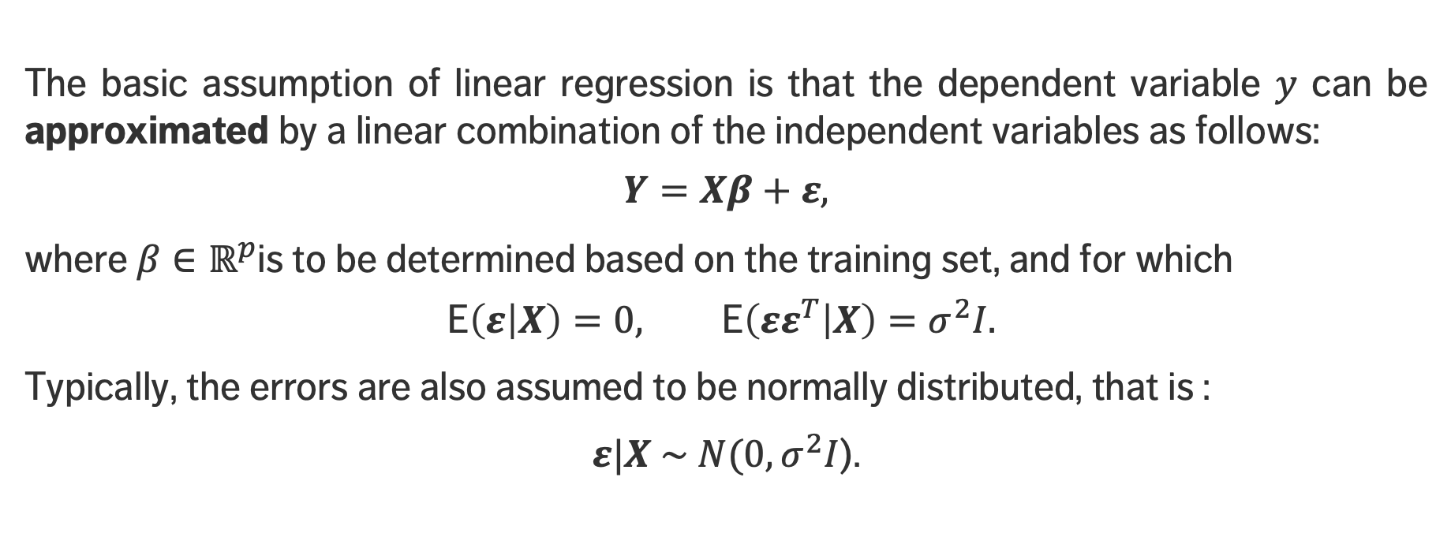
Linear Regression
The basic assumption of linear regression is that the dependent variable $y$ can be approximated by a linear combination of the independent variables as follows:
$$Y=Xβ+ε,$$
where $β∈ℝ^{p}$is to be determined based on the training set, and for which
$$\text{E}\left(ε | X\right)=0, \text{E}\left(εε^{T} | X\right)=σ^{2}I.$$
Typically, the errors are also assumed to be normally distributed, that is :
$ε|X \sim N(0, σ^{2}I$).

Slide 9
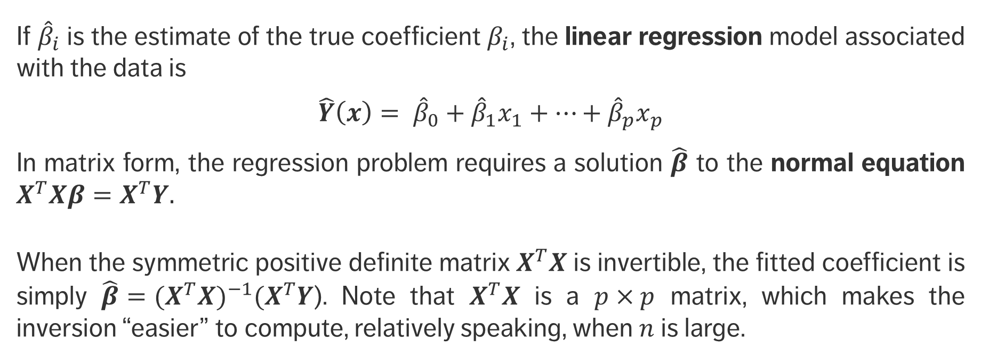
Linear Regression
If ${\hat{β}}_{i}$ is the estimate of the true coefficient $β_{i}$, the linear regression model associated with the data is
$$\hat{Y}\left(x\right)= {\hat{β}}_{0}+{\hat{β}}_{1}x_{1}+⋯+{\hat{β}}_{p}x_{p}$$
In matrix form, the regression problem requires a solution $\hat{β}$ to the normal equation $X^{T}Xβ=X^{T}Y.$
When the symmetric positive definite matrix $X^{T}X$ is invertible, the fitted coefficient is simply ${{\hat{β}=(X}^{T}X)}^{−1}{(X}^{T}Y$). Note that $X^{T}X$ is a $p×p$ matrix, which makes the inversion “easier” to compute, relatively speaking, when $n$ is large.

Slide 10
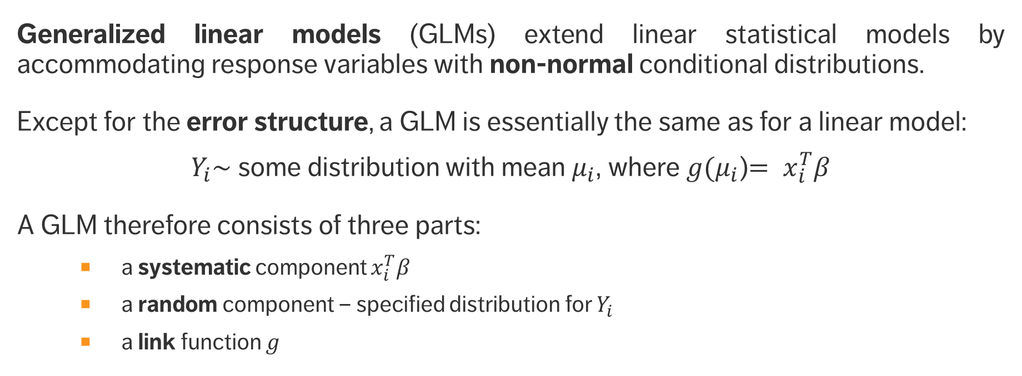
Generalized Linear Regression
Generalized linear models (GLMs) extend linear statistical models by accommodating response variables with non-normal conditional distributions.
Except for the error structure, a GLM is essentially the same as for a linear model:
$Y_{i}\sim$some distribution with mean $μ_{i}$, where$g(μ_{i}$)$= x_{i}^{T}β$
A GLM therefore consists of three parts:
a systematic component $x_{i}^{T}β$
a random component – specified distribution for $Y_{i}$
a link function $g$

Slide 11
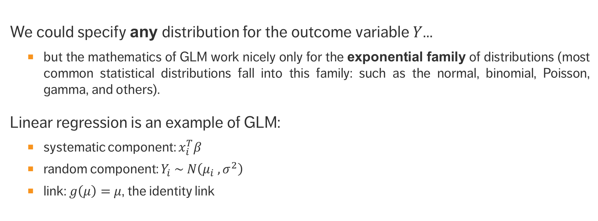
Generalized Linear Regression
We could specify any distribution for the outcome variable $Y$…
but the mathematics of GLM work nicely only for the exponential family of distributions (most common statistical distributions fall into this family: such as the normal, binomial, Poisson, gamma, and others).
Linear regression is an example of GLM:
systematic component: $x_{i}^{T}β$
random component: $Y_{i} \sim N\left(μ_{i} , σ^{2}\right)$
link: $g\left(μ\right)=$ $μ$, the identity link

Slide 12
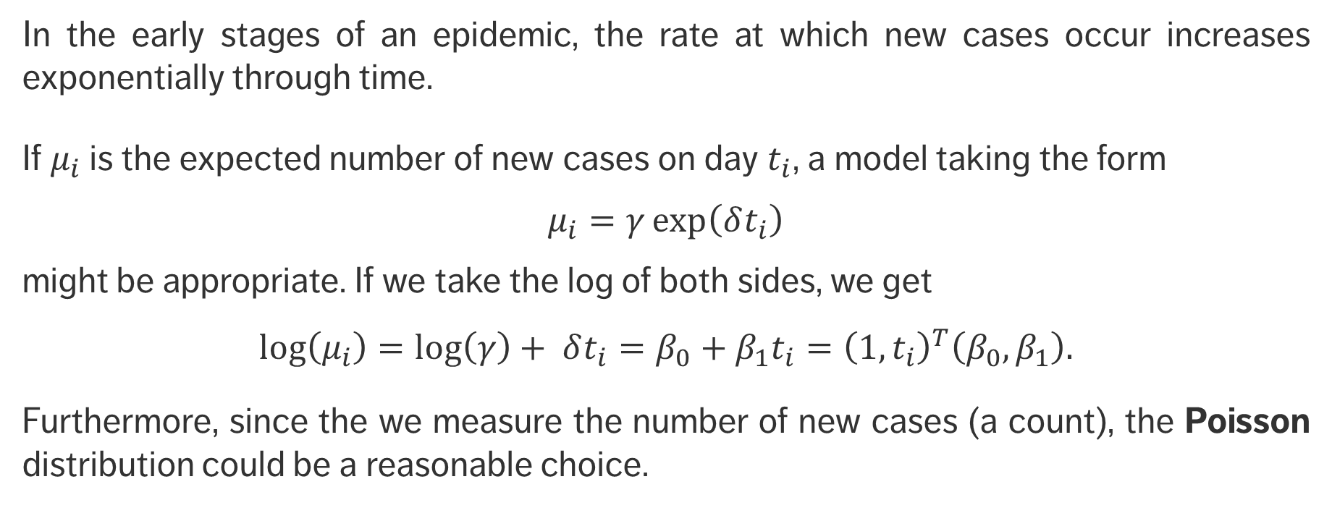
EXAMPLE
In the early stages of an epidemic, the rate at which new cases occur increases exponentially through time.
If $μ_{i}$ is the expected number of new cases on day $t_{i}$, a model taking the form
$μ_{i}=γ\exp\left(δt_{i}\right)$
might be appropriate. If we take the log of both sides, we get
$$\text{log}\left(μ_{i}\right)=\text{log}\left(γ\right)+ δt_{i}=β_{0}+β_{1}t_{i}={\left(1,t_{i}\right)}^{T}\left(β_{0},β_{1}\right).$$
Furthermore, since the we measure the number of new cases (a count), the Poisson distribution could be a reasonable choice.
link
systematic component
random component

Slide 13
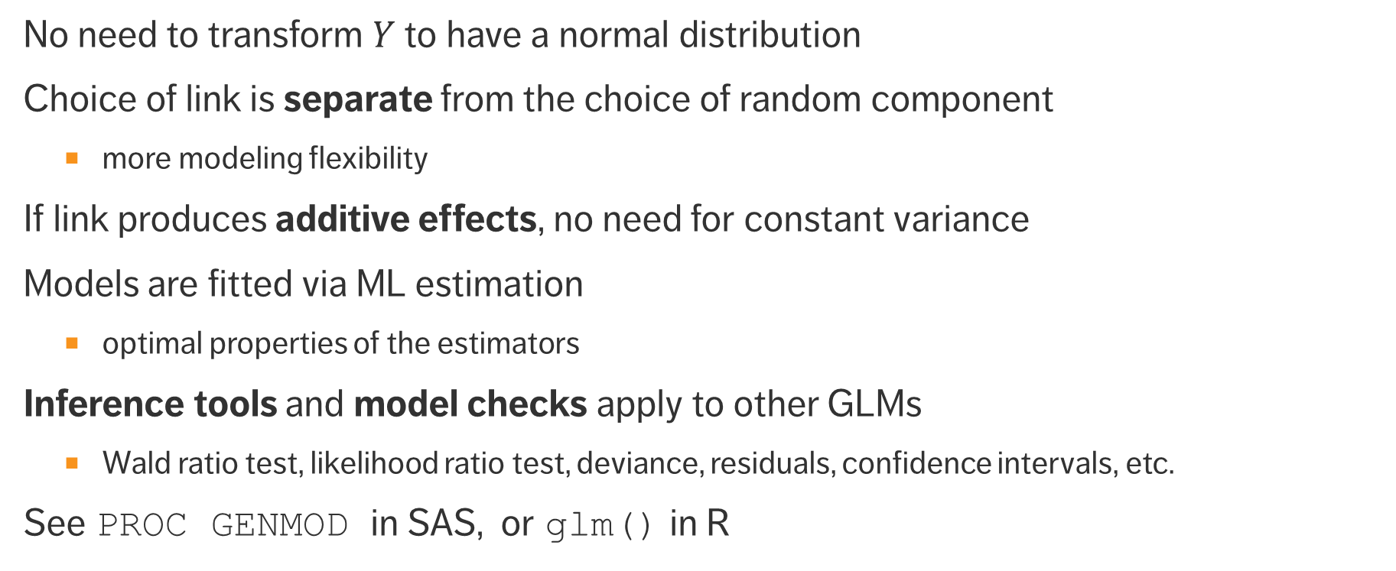
Advantages of GLM
No need to transform $Y$ to have a normal distribution
Choice of link is separate from the choice of random component
more modeling flexibility
If link produces additive effects, no need for constant variance
Models are fitted via ML estimation
optimal properties of the estimators
Inference tools and model checks apply to other GLMs
Wald ratio test, likelihood ratio test, deviance, residuals, confidence intervals, etc.
See PROC GENMOD in SAS, or glm() in R

Slide 14
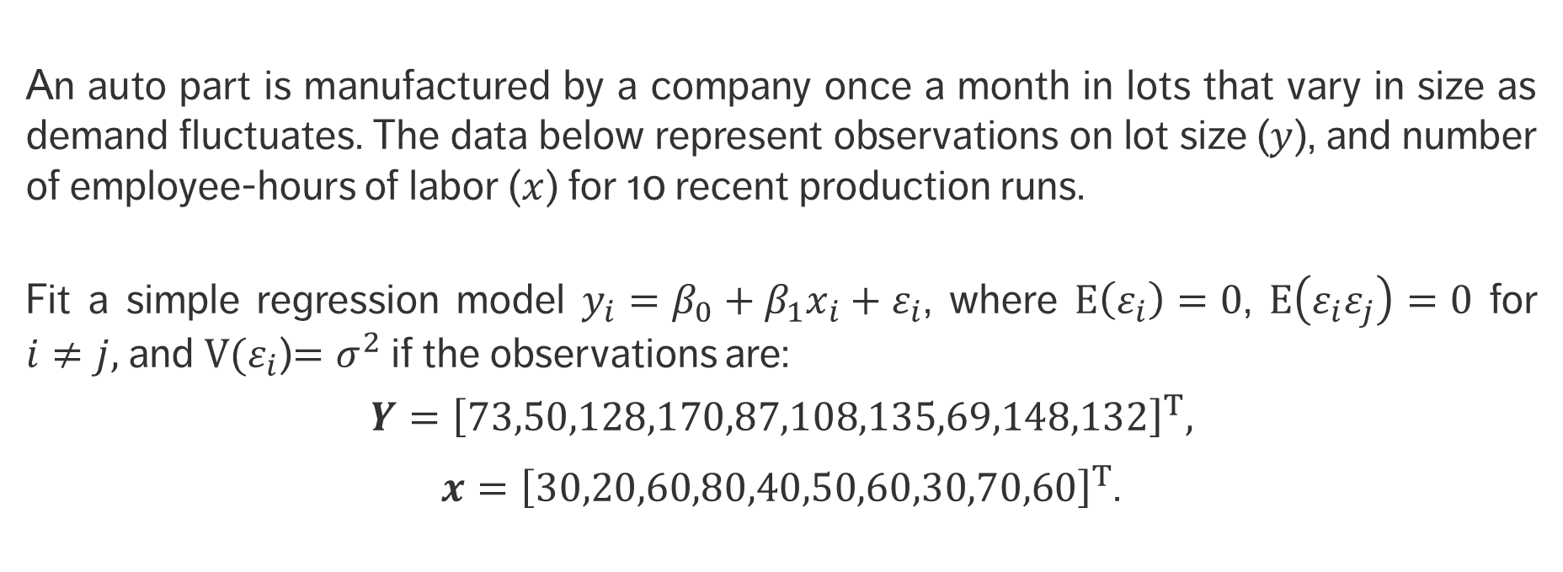
EXERCISE
An auto part is manufactured by a company once a month in lots that vary in size as demand fluctuates. The data below represent observations on lot size ($y$), and number of employee-hours of labor ($x$) for 10 recent production runs.
Fit a simple regression model $y_{i}=β_{0}+β_{1}x_{i}+ε_{i}$, where $E\left(ε_{i}\right)=0$, $E\left(ε_{i}ε_{j}\right)=0$ for $i≠j,$and $V(ε_{i}$)$=σ^{2}$ if the observations are:
$$Y={\left[73,50,128,170,87,108,135,69,148,132\right]}^{T},$$
$x={\left[30,20,60,80,40,50,60,30,70,60\right]}^{T}$.

Slide 15
Time Series Analysis

Slide 16
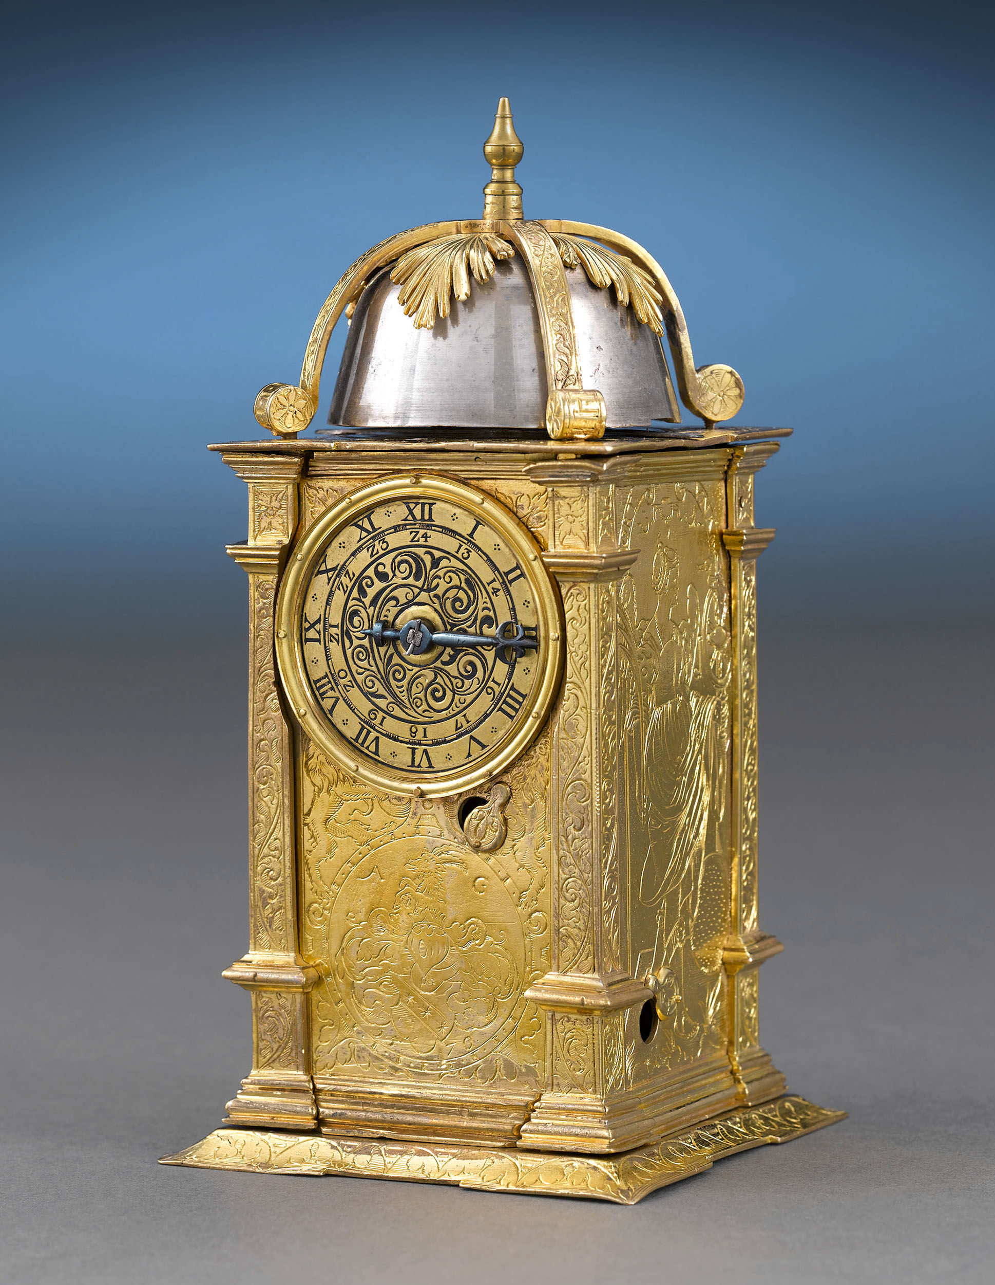
A Matter of Time
When one of our independent variables is time, we can use specialized techniques to model the relationships between time and other variables.
This is referred to as time series analysis.
Rauantiques [CC BY-SA 4.0 (https://creativecommons.org/licenses/by-sa/4.0)]

Slide 17
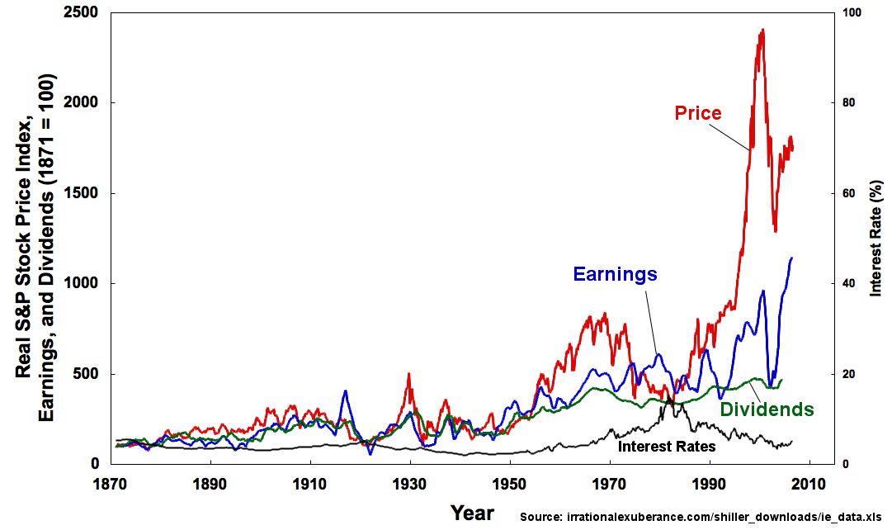
Time Series Analysis
A simple time series has two variables: a time variable, and second variable
What is the pattern of behaviour of this second variable over time?
Can we use this information to forecast the behaviour of the variable in the future?

Slide 18
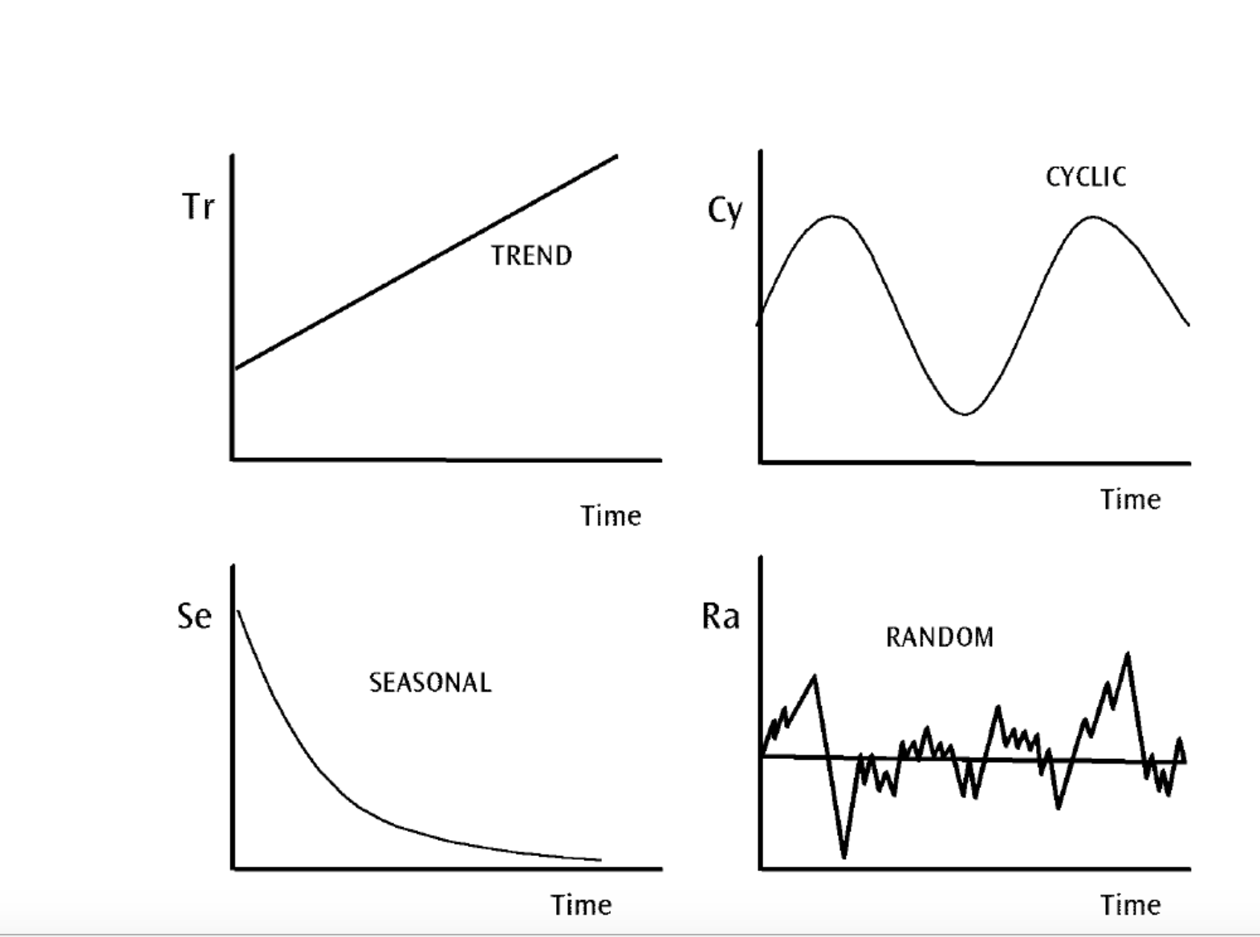
Temporal Patterns
The goal here is our familiar analysis goal:
find patterns in the data
create a (mathematical) model that captures the essence of these patterns

Slide 19
Temporal Patterns
The patterns can be quite complex – some ‘fancy’ analysis typically required!
In particular – the overall series can often be broken down into being made up of multiple component models.
Common techniques involve moving averages – e.g. ARIMA.
There are software libraries that can help!

Slide 20
OTHER PREDICTION STRATEGIES?

Slide 21
The New Kids On the PREDICTION BLOCK
Regression is a tried and true strategy for prediction.
Regression techniques frequently rely on certain assumptions – e.g. about the appropriate underlying model.
Are there other techniques that might be useful for prediction?
Enter machine learning techniques.
Right now, neural network are a popular predictive technique.

Slide 22
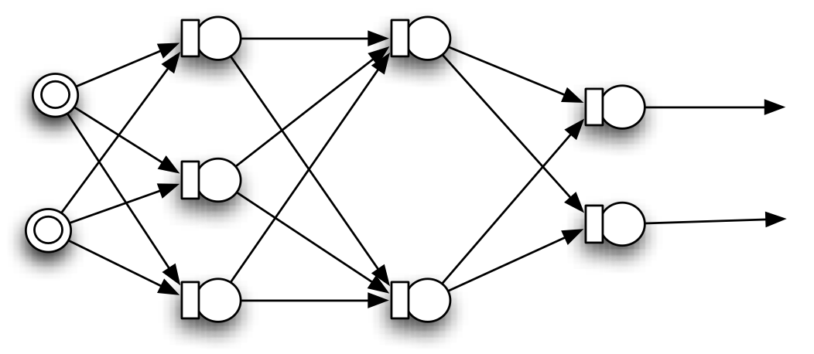
NEURAL NETWORKS

